Slide 1
Integrating the Healthcare Enterprise
IHE Overview
Keith W. Boone
Interoperability Architect, GE Healthcare
Co-chair, IHE Patient Care Coordination PC
Co-chair, HL7 Structured Documents TC
Co-chair, ANSI/HITSP Care Management and Health Records TC
Member, US-TAG
Member, Continua

Slide 2
Integrating the Healthcare Enterprise
Over 100 vendors and 20 professional societies involved worldwide
Numerous Technical Frameworks and 70+ integration profiles
Testing at Connectathons and Demonstrations at Major Conferences Worldwide
Electronic Health Record
1999
2002
Radiology
Cardiology
2002
IHE
Patient Care
Laboratory
2003
IT Infrastructure
2005
Coordination
Future
2005
Patient Care
Domains
2005
2004
Devices
2005
Pathology
Oncology
Eye Care

Slide 3
IHE Domains Milestones – 20 month cycle
Development and Deployment
Proposed Scope
- 10 ---
2009 Season
Approved Scope
- 7 ---
Sponsors announce Connect-a-thon/Demos with set of Implementation Profiles
Public Comment
- 2 ---
Trial Implementation
0 ---
Connect-a-thon/Demo Vendor Participant Registered
+ 2 ---
2008 Season
+ 5 ---
Vendor Participant passed Connectathon
+ 6 ---
Demo &
Education Material
Final Integration Profile
+ 9 ---
Vendors release products with IHE Integration Statements
---

Slide 4
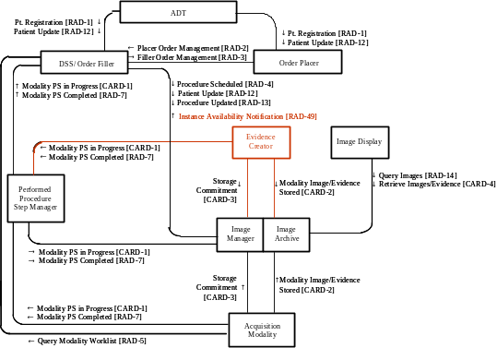
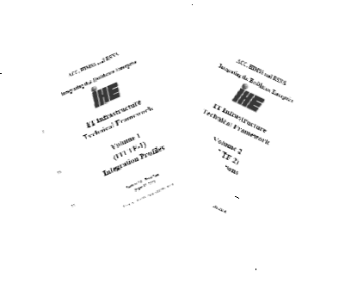
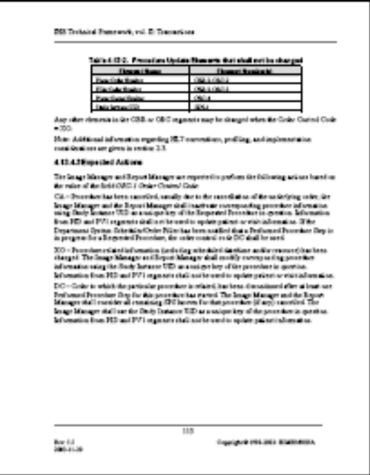
IHE Profiles
Actor/Transaction Diagrams
Department System
Department System
Image
Order
Image
Order
Acquisition
ADT
Acquisition
ADT
Scheduler/
Scheduler/
Manager/
Placer
Manager/
Placer
Modality
Order Filler
Modality
Order Filler
PPS Manager
Register
PPS Manager
Register
J.Doe
Patient
J.Doe
Patient
Registration [RAD
Registration [RAD
-
-
1]
1]
Placer Order
Placer Order
Sequence Diagrams
Management
Management
–
One or the
–
One or the
New [RAD
New [RAD
-
-
2]
other methods
2]
other methods
of creating an
of creating an
Filler Order
order is used
Filler Order
order is used
Management
Management
-
-
Schedule
New [RAD
Schedule
New [RAD
-
-
3]
3]
Procedure
Procedure
Procedure
Procedure
Scheduled [RAD
Scheduled [RAD
-
-
4]
4]
Query Modality Worklist [RAD
Query Modality Worklist [RAD
-
-
5]
5]
Perform
Modality Procedure
Perform
Modality Procedure
Modality Procedure
Filler Order
Modality Procedure
Filler Order
Acquisition
Step In Progress
Acquisition
Step In Progress
Step In Progress
Mgmt
Step In Progress
Mgmt
-
-
Status
Status
[CARD
[CARD
-
-
1]
1]
[CARD
[CARD
-
-
1]
Update [RAD
1]
Update [RAD
-
-
3]
3]
Modality Procedure
Modality Procedure
Modality Procedure
Patient Reconciliation
Modality Procedure
Patient Reconciliation
Filler Order
Filler Order
Step Completed
Step Completed
Step Completed
Mgmt
Step Completed
Mgmt
-
-
Status
Status
[RAD
[RAD
-
-
7]
[RAD
7]
[RAD
-
-
7]
J.Doe
7]
J.Doe
-
-
>
>
Update [RAD
Update [RAD
-
-
3]
J.Smith
3]
J.Smith
Patient Update/
Patient Update/
Patient Update/
Merge [RAD
Patient Update/
Merge [RAD
-
-
12]
12]
Merge [RAD
Merge [RAD
-
-
12]
12]
Detailed standards implementation guides
Textual Description

Slide 5
Proposals
The Problem
Key Use Case
Available Standards
Systems In Use
Discussion

Slide 6
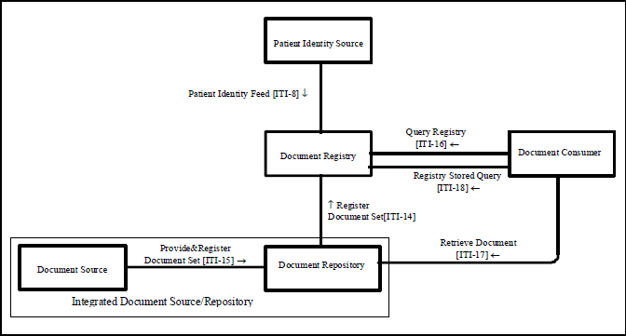
An integration profile …
Describes actors and transactions allowing exchange to occur

Slide 7
A content profile …
A sharable information component that can be exchanged…
  within an HIE or RHIO (XDS)
  via Media or USB Device (XDM)
  via Reliable Messages (XDR)
Document content using standards
  CDA Release 2.0
  HL7 Care Record Summary
  ASTM/HL7 Continuity of Care Document
Library of Reusable Parts

Slide 8
Schedule
Development Schedule
Call for Proposals: August February
Reviews: September
Planning Committee: October
Technical Committee: November
Planning Committee Decision: December
IHE Connectathon: January
HIMSS Demo: February
Technical Committee Face to Face: March
Development: April-May
Technical Committee Face to Face: June
Public Comments: July
Technical Committee Face to Face: August
Issue Trial Implementation version: August

Slide 9
Objectives
Collaborating nationally/internationally for profile adoption related to interoperability
Many perspectives participating together towards the goal of HIT interoperability
Monitoring image & integrity throughout IHE
Respect for all perspectives, even if we disagree with the message
Knowledge IHE domains are contributing to the worldwide IHE collaboration

Slide 10
Collaborating nationally/internationally for profile adoption related to interoperability
IHE workflow is a provider of solutions to business, government and society
  Conduct activities in a respectful manner
  Transparent and consensus based process
    Experts participate on behalf of their employer
    Concerned stakeholders may also participate
  Provide realistic and state of the art solutions
Each IHE participant broadly represents standardization from their own perspective, workflow, employer or marketplace need

Slide 11
Many perspectives participating together towards the goal of HIT interoperability
Respond effectively to requirements, market needs and scientific/ technical developments
  Do not give preference to the requirements of specific stakeholders, companies or organizations
  Concepts/new item topics are performance-based rather than design-prescriptive
  Attend the meetings with an open attitude moving in a collaborative manner
  Respond to questions in a respectful manner
    Do not “overtalk” another person
    Allow each person the opportunity to express their views

Slide 12
Respect for all perspectives, even if we disagree with the message
Six key goals:
  Individualistic yet restrained
  Egalitarian yet respectful
  Assertive, but sensitive
  Accurate, yet tactful
  Punctual, yet patient
  Optimal, yet practical

Slide 13
Developing relevant International IHE Profiles
Ensuring fair and responsive application of the principles of due process, transparency, openness, impartiality and voluntary nature of standardization
  Relevant interests at the national level
  Participation of consumers, subject matter experts & public authorities

Slide 14
Monitoring IHE’s image & integrity
Act on behalf and in the interest of IHE when working in an IHE Domain:
  Maintaining openness and transparency in all aspects of IHE profile development
  Facilitate the participation of all affected parties contribution to the development process
  Prevent conflicts of interest by communicating in an open and transparent manner
  Maintain professionalism towards all IHE experts and participating members

Slide 15


